Slide 1
CO
CF
P
IS
E
C
D
A
P
P
P
IS
IS
G
B
B
F
G
H
Plate 1. Brightfield microscope images of commonly encountered nematodes found in North American millipedes. A) Heth sp. female showing cervical folds (arrow). B). Heth male, note distinct esophageal glands (arrow) and lack of cephalic structures. C) Thelastoma sp., female with long, narrow procorpus (arrow). D) Stauratostoma shelleyi, female with constricted mushroom shaped head (arrow). E) Coronostoma claireae, female, hour-glass shaped esophagus with short isthmus (arrow). F) Aoruroides sp., female with vase-shaped procorpus and isthmus longer than basal bulb (arrows). G) Aorurus sp. female, with pyriform-shaped procorpus and short, muscular swelling of isthmus (metacorpus) (arrows). H) Rhigonema sp., female showing robust procorpus and basal bulb with grinding valve (arrows). Abbreviations: (B) Basal bulb; (CF) Cervical folds; (CO) Constriction; (G) Glands; (IS) Isthmus; and, (P) Procorpus.

Slide 2
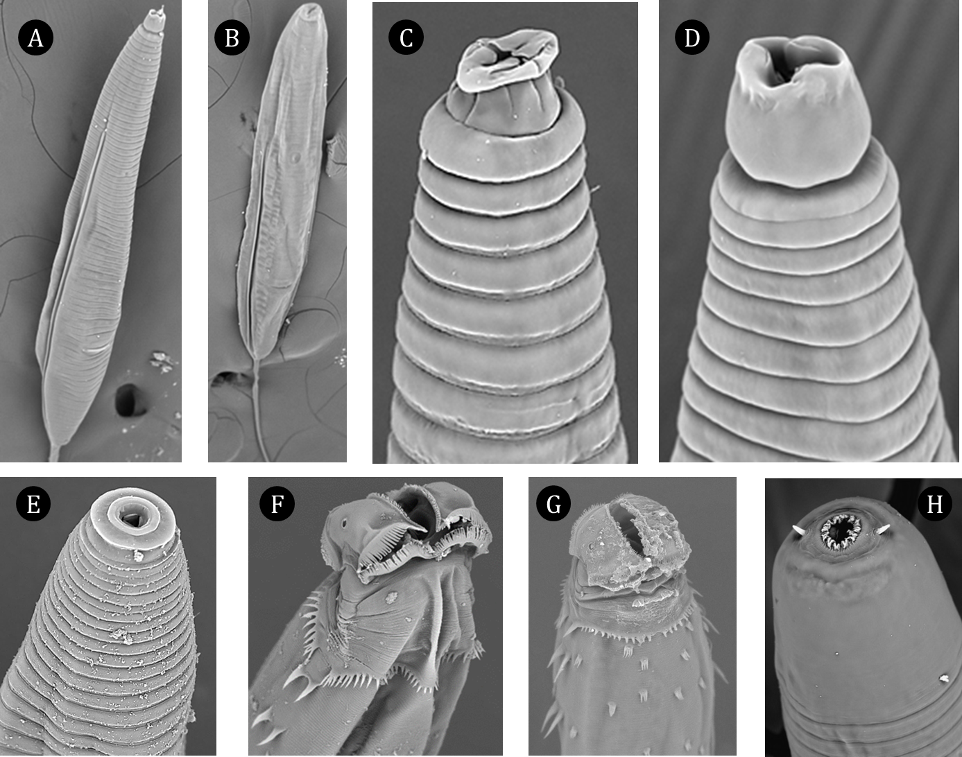
Plate 2. Scanning electron microscope images of commensal nematodes. A) Thelsatoma sp. female. B) Thelastoma sp. female. C) Stauratostoma shelleyi female. D) Thelastoma sp. female, anterior view. E) Aorurus sp. female. F) Heth pivari female, note strong cuticular and cephalic ornamentation. G) Heth mauriesi female showing multi-cusped lappets. H) Coronostoma claireae female, a nematophagus nematode.

